Slide 1

(2-1) Numeric Expressions in C
H&K Chapter 2
Instructor - Andrew S. O’Fallon
CptS 121 (January 16, 2013)
Washington State University
Notes:
C. Hundhausen, A. O’Fallon

Slide 2
Arithmetic Expressions
Most programming problems require arithmetic expressions as part of solution; including problems related to:
  Mechanics
  Kinematics
  Materials science
  Electronics
  Many others…
Require numerical operands
Form: operand1 operator operand2
Type of result dependant on operand types
C. Hundhausen, A. O’Fallon
Notes:
C. Hundhausen, A. O’Fallon

Slide 3
Arithmetic Operators in C (1)
Operator | Representation | Example
+ | Addition | 10 + 5 = 15 1.55 + 13.3 = 14.85 3 + 100.7 = 103.7
- | Subtraction | 10 – 5 = 5 5.0 – 10.0 = -5.0 10 – 5.0 = 5.0
* | Multiplication | 1 * 5 = 5 1.000 * 10.0 = 10.0 5 * 5.0 = 25.0
C. Hundhausen, A. O’Fallon
Notes:
C. Hundhausen, A. O’Fallon

Slide 4
Arithmetic Operators in C (2)
Operator | Representation | Example
/ | Division | 2 / 3 = 0 10.0 / 4.0 = 2.5 10 / 3.0 = 3.3333
% | Modulus | 5 % 2 = 1 2 % 5 = 2 6 % 0 = undefined 6.0 % 3 = won’t compile
C. Hundhausen, A. O’Fallon
Notes:
C. Hundhausen, A. O’Fallon

Slide 5
Mixed-Type Expressions
Types of operands in expression are different
  An integer value and a double value
The result is always the more precise data type
  10 (an int) + 25.5 (a double) = 35.5 (a double)
C. Hundhausen, A. O’Fallon
Notes:
C. Hundhausen, A. O’Fallon

Slide 6
Mixed-Type Assignment Statements
Evaluated from right-to-left
Expression is first evaluated (what’s on right-hand-side) and then assigned to variable (what’s on left-hand-side)
Examples:
  int result_int, op1_int = 5, op2_int = 42;
  double result_double, op1_double = 5.5;
  result_int = op1_int + op1_double; /* mixed expression, integer assignment, result_int = 10 (truncation occurs) */
  result_double = op1_int + op2_int; /* integer expression, double assignment, result_double = 47.0*/
  result_double = op1_int + op1_double; /* mixed expression, double assignment, result_double = 10.5*/
C. Hundhausen, A. O’Fallon
Notes:
C. Hundhausen, A. O’Fallon

Slide 7
Type Conversions & Type Casts
Changing one entity of a data type into another
Two kinds exist:
  Implicit
  Explicit
Implicit type conversion example:
  int num1 = 12;
  double num2;
  num2 = num1; /* num1 implicitly casted to type double, 12.0 */
Explicit type conversion example:
  double num1;
  num1 = ((double) 1 / 5); /* integer 1 explicitly casted to type double, 1.0 */
C. Hundhausen, A. O’Fallon
Notes:
C. Hundhausen, A. O’Fallon

Slide 8
Multiple Operator Expressions
May contain unary and binary operators
Unary operators consists of one operand
Binary operators require two operands
Example:
  y = -x + x * x / 10; /* -x applies the unary sign operator for negation */
C. Hundhausen, A. O’Fallon
Notes:
C. Hundhausen, A. O’Fallon

Slide 9
Operator Precedence (1)
Operator Precedence
  How is x – y / z evaluated?
    (x – y) / z ?
    x – (y / z) ?
  Important to understand operator precedence rules:
    Evaluation proceeds left to right
    Subexpressions in parentheses are evaluated first
    In cases where no parentheses are used, *, /, and % take precedence over + and –
  So x – y / z is evaluated as x – (y / z), because / takes precedence over –
  Note: The unary operators + and – are used to indicate the sign of a number (e.g., +5, -3.0). They take precedence over all binary operators, and are evaluated right to left:
    Example: -3 + 5 * 4 would be evaluated as (-3) + (5 * 4) = 17.
  Recommendation: Liberally use parentheses to avoid confusion and unexpected results!
C. Hundhausen, A. O’Fallon
Notes:
C. Hundhausen, A. O’Fallon

Slide 10
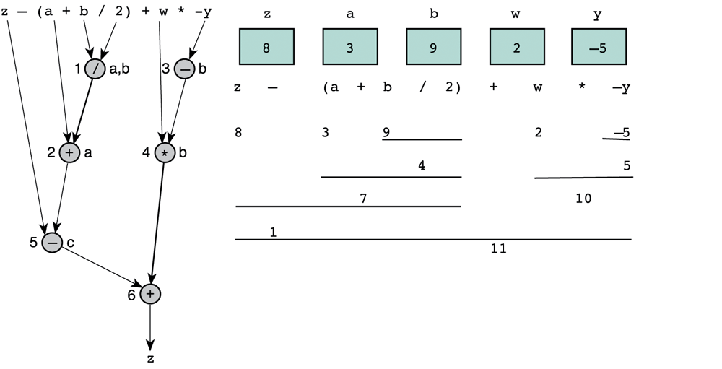
Operator Precedence (2)
Operator Precedence Example (H & K p. 80)
C. Hundhausen, A. O’Fallon
Notes:
C. Hundhausen, A. O’Fallon

Slide 11
Formatting Numbers (1)
C defines "default" output style for each data type
  No leading blanks for int and double
  double displayed with default number of digits to right of decimal point (how many?)
You can override these defaults by specifying custom format strings to printf function
int x;
double y;
x = 3;
y = 2.17;
printf("x is %3d. y is %5.1f.",x,y);
Output:
x is 3. y is 2.2.
C. Hundhausen, A. O’Fallon
Notes:
C. Hundhausen, A. O’Fallon

Slide 12
Formatting Numbers (2)
Notes:
  For double output, format string is of form %n.mf, where n is total width (number of columns) of formatted number, and m is the number of digits to the right of decimal point to display.
  It is possible to omit n. In that case, no leading spaces are printed. m can still specify the number of decimal places (e.g., %.2f)
C. Hundhausen, A. O’Fallon
Notes:
C. Hundhausen, A. O’Fallon

Slide 13
Formatting Numbers (3)
You try it:
  If the values of the variables a, b, and c are 504, 302.558, and -12.31, write a statement that will display the following line ( □is used to denote a blank):
  □□504□□□□□302.56□□□□-12.3
  printf(“%5d%11.2f%9.1f”,a,b,c);
C. Hundhausen, A. O’Fallon
Notes:
C. Hundhausen, A. O’Fallon

Slide 14
Programming Errors (1)
Rarely will you write a program that is free of errors
You'll need to diagnose and correct three kinds of errors:
  Syntax errors (code violates syntax rules for a proper C program)
    Detected at compile time
    An executable file will not be generated unless they’re corrected
    Examples:
      Missing semi-colon
      Unmatched brace
      Undeclared identifiers
      Failure to close a comment properly
    Note: Removing one error may make others disappear (the compiler gets confused easily) – Always start with the first error listed by the compiler!!!
C. Hundhausen, A. O’Fallon
Notes:
C. Hundhausen, A. O’Fallon

Slide 15
Programming Errors (2)
  Run-time errors
    Commonly called "bugs"
    Cause the program to "crash": an error is reported, and control is turned over to the operating system
    Examples
      Division by zero
      Referencing a memory cell that's out of range
      Getting into an infinite loop, which may ultimately cause a "stack overflow"
      Referencing a null pointer (more on this later…)
C. Hundhausen, A. O’Fallon
Notes:
C. Hundhausen, A. O’Fallon

Slide 16
Programming Errors (3)
  Logic Errors
    Cause the program to compute incorrect results
    Often go unnoticed, at least at first
    Examples
      Your algorithm is wrong because you misunderstand the problem
      You do not obtain input data properly, so your computations work on the wrong data. For example:
      int year;
      char first, middle, last;
      printf("Enter the current year and press return: ");
      scanf("%d", &year);
      printf("Type in 3 initials and press return: ");
      scanf("%c%c%c", &first, &middle, &last);
      What goes wrong here?
C. Hundhausen, A. O’Fallon
Notes:
C. Hundhausen, A. O’Fallon

Slide 17
Next Lecture…
Top-Down Design and Functions
C. Hundhausen, A. O’Fallon
Notes:
C. Hundhausen, A. O’Fallon

Slide 18
References
J.R. Hanly & E.B. Koffman, Problem Solving and Program Design in C (7th Ed.), Addison-Wesley, 2013
C. Hundhausen, A. O’Fallon
Notes:
C. Hundhausen, A. O’Fallon

Slide 19
Collaborators
Chris Hundhausen
C. Hundhausen, A. O’Fallon
Notes:
C. Hundhausen, A. O’Fallon

